Slide 1
3.3 Logic Gates
22
We have looked at Boolean functions in abstract terms.
In this section, we see how Boolean functions can be implemented in digital computer circuits called gates.
A gate is an electronic device that produces a result based on two or more input values.
  Technically, one or more input values, since a NOT gate only has one input.
  In reality, gates consist of one to six transistors, but digital designers think of them as a single unit.
  Integrated circuits contain collections of gates suited to a particular purpose.

Slide 2
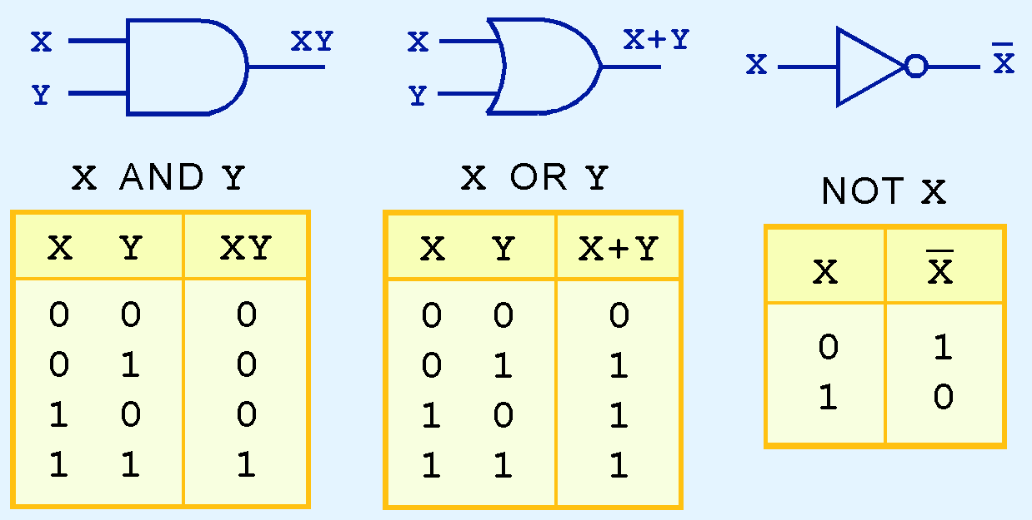
3.3 Logic Gates
23
The three simplest gates are the AND, OR, and NOT gates.
They correspond directly to the Boolean AND, OR and NOT operators.

Slide 3
3.3 Logic Gates
23b
In this orientation, the left side is the input and the right side is the output.
The small circle on the output side of the NOT gate is a symbol for inversion.

Slide 4
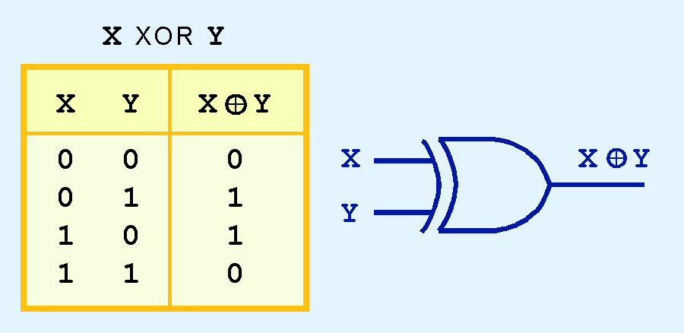
3.3 Logic Gates
24
Another very useful gate is the exclusive OR (XOR) gate.
The output of the XOR operation is true only when the values of the inputs differ.
X XOR Y = X or Y but not both.
Note the special symbol ⊕ for the XOR operation.

Slide 5
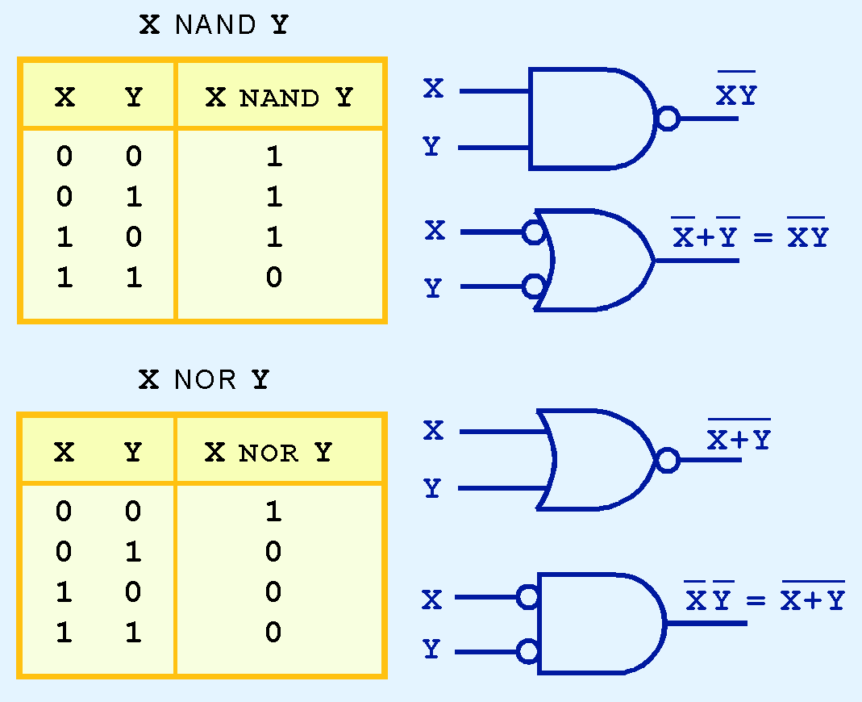
3.3 Logic Gates
25
NAND and NOR are two very important gates. Their symbols and truth tables are shown at the right.
X NAND Y =
NOT (X AND Y)
X NOR Y =
NOT (X OR Y)

Slide 6
3.3 Logic Gates
25a
Since X NAND Y =
NOT (X AND Y), the symbol for NAND consists of the symbol for X AND Y followed by a small circle to invert (negate) the result.
DeMorgan’s Law can be used to build an equivalent symbol based on an OR gate.

Slide 7
3.3 Logic Gates
25b
Similarly for NOR:
Since X NOR Y =
NOT (X OR Y), the symbol for NAND consists of the symbol for X OR Y followed by a small circle to invert (negate) the result.
DeMorgan’s Law can be used to build an equivalent symbol based on an AND gate.

Slide 8
3.3 Logic Gates
25c
NAND and NOR are universal gates
A universal gate means that any Boolean function can be constructed using all NAND gates or all NOR gates
  This makes NAND and NOR different from gates like AND and OR, which are not universal gates
  Since NAND and NOR are inexpensive to manufacture, this is a useful property
To show that NAND is a universal gate, we need to show that the basic gates AND, OR and NOT can be built from NANDs

Slide 9
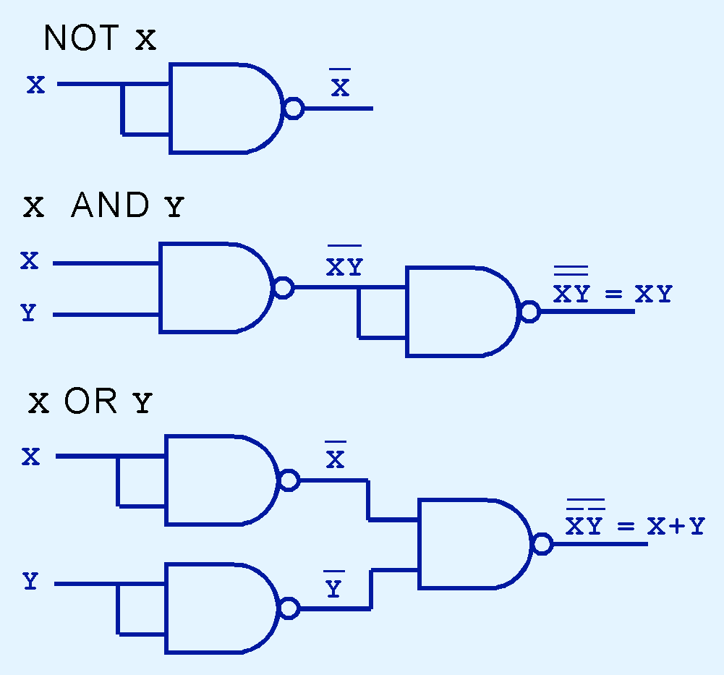
3.3 Logic Gates
26
This picture shows how to build NOT, AND and OR from NANDs.
The top diagram shows the input x being used twice.
It states that
X NAND X = X’

Slide 10
3.3 Logic Gates
26b
Proof that X NAND X = -X
X NAND X =
-(X AND X) = definition of NAND
-X OR -X = De Morgan’s Law
-X idempotent law

Slide 11
3.3 Logic Gates
26c
The middle diagram shows how to build
X AND Y
from NANDs

Slide 12
3.3 Logic Gates
26d
Proof that X AND Y can be built from NANDs
(X NAND Y) NAND (X NAND Y) =
-(X AND Y) NAND -(X AND Y) =
-(-(X AND Y) AND -(X AND Y)) =
-(-(X AND Y)) =
X AND Y

Slide 13
3.3 Logic Gates
26e
The bottom diagram shows how to build X OR Y from NANDs

Slide 14
3.3 Logic Gates
26f
Proof that X OR Y can be built from NANDs
(A NAND A) NAND (B NAND B) =
-(A AND A) NAND -(B AND B) = defn
-A NAND -B = idempotent law
-(-A AND -B) = defn of NAND
--A OR --B = DeMorgan’s Law
A OR B double complement law

Slide 15
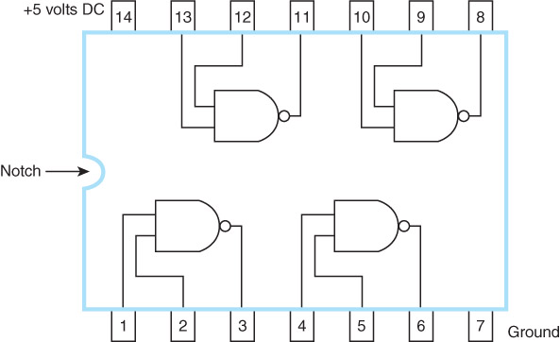
3.3 Logic Gates
26g
This is an integrated circuit containing 4 NAND gates. You can connect any inputs or outputs to
the corres- ponding pin number.
The ones used today are many orders of magnitude larger.

Slide 16
3.3 Logic Gates
26h
Integrated circuits used in computers today are many orders of magnitude larger than the one shown in the previous slide.
But the one shown is still extremely useful if you want to build a small circuit yourself.

Slide 17
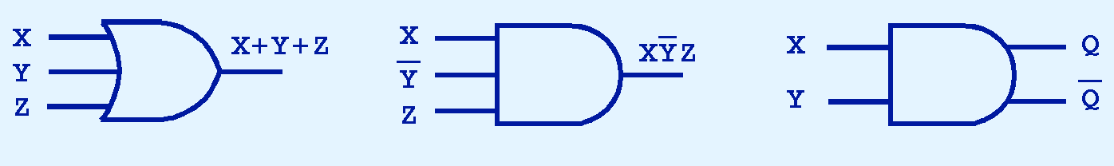
3.3 Logic Gates
27
Gates can have multiple inputs and more than one output.
A gate showing 3 or more inputs is really an abbreviation for a series of gates. This is made possible by the associative and commutative laws for AND and OR.
  The Y’ in the middle diagram is just an example; it could also be plain Y or a more complex function.

Slide 18
3.3 Logic Gates
27b
A gate with more than one output is an abbreviation for a set of gates with the same input, where each of them provides one of the outputs.
  The second output is often the complement of the first one.

Slide 19

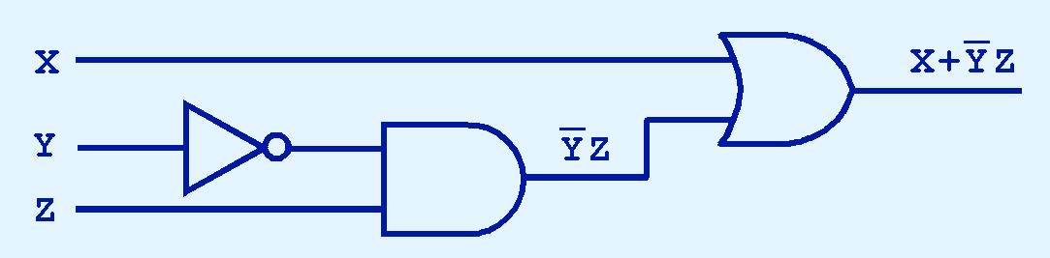
3.4 Digital Components
28
Boolean functions are implemented with combinations of gates.
Example: The circuit below implements:

